Slide 1
Object Oriented Programming—C++ Lecture5 Containers
Qijun Zhao
College of Computer Science
Sichuan University
Spring 2023

Slide 2
Today
-Defining Containers
What is a container in C++?
- Containers in the STL vs Stanford
Types of containers and how they work
- Container Adaptors
Abstracting container implementation

Slide 3
Container: An object that allows us to
collect other objects together and interact
with them in some way.
Think of vectors, stacks, or queues!

Slide 4
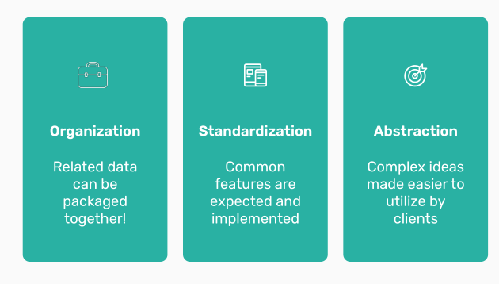
Why
containers?
What is the purpose of
container types in
programming
languages?

Slide 5
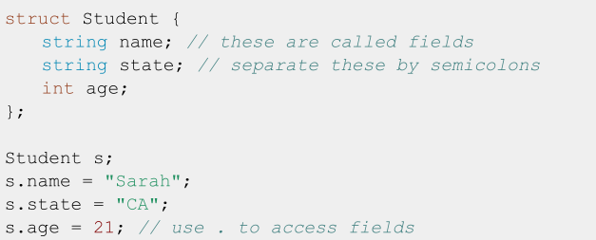

Motivating containers
We’ve been using the idea of a Student struct for the past few lectures:

Slide 6
This is generalizable!
What if we need to store other types of data?
● Class grades
● Coordinates in a graph
● Mountains
What if we want to store it in a different way?
● FIFO vs LIFO
● Ascending order by some value

Slide 7
Today
-Defining Containers
What is a container in C++?
- Containers in the STL vs Stanford
Types of containers and how they work
- Container Adaptors
Abstracting container implementation

Slide 8
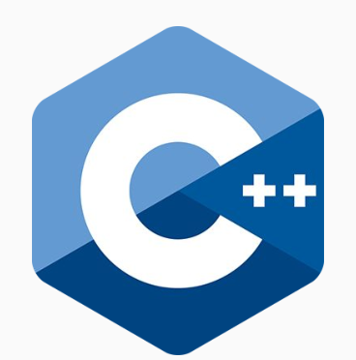
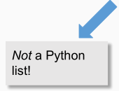
The STL has many types of containers:
Both familiar:
● Vector
● Stack
● Queue
● Set
● Map
And unfamiliar:
● Array
● Deque
● List
● Unordered set
● Unordered map

Slide 9
New containers
● An array is the primitive form of a vector
○ Fixed size in a strict sequence
● A deque is a double ended queue
● A list is a doubly linked list
○ Can loop through in either direction!

Slide 10
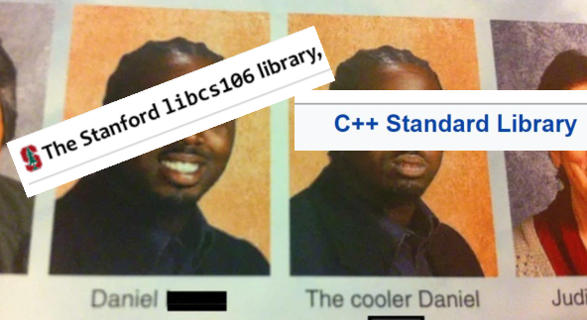
STL vs Stanford
The Stanford library and the STL containers have very similar functionality, but there can sometimes be key differences in both behavior and syntax!

Slide 11
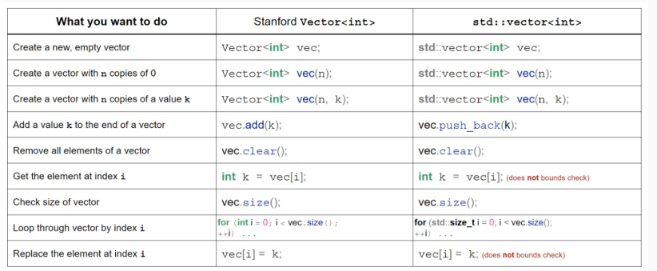
Spot the difference!
Table courtesy of Frankie Cerkvenik and Sathya Edamadaka!

Slide 12
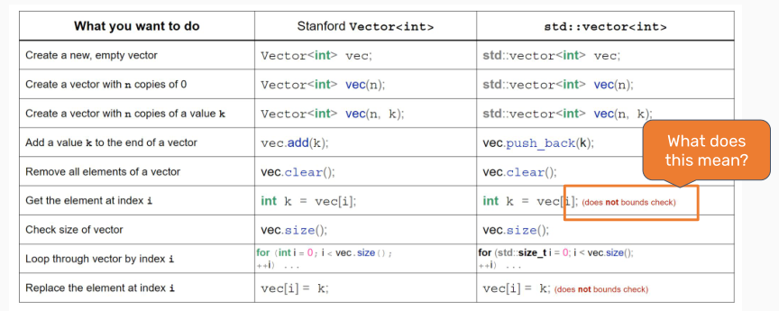
Spot the difference!

Slide 13
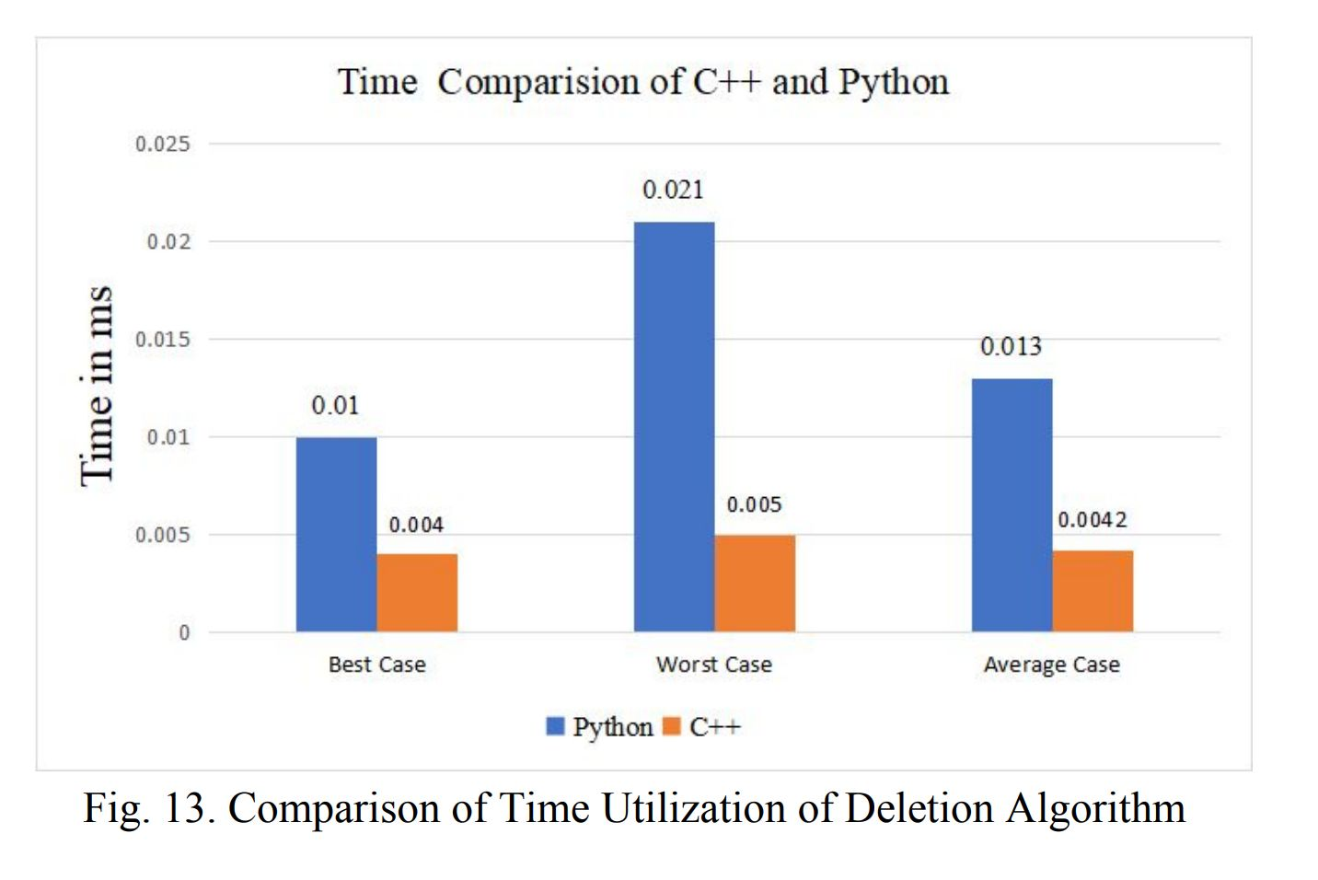
Safety vs Speed
In choosing a programming language, there’s
always a tradeoff between speed, power, and
safety.
C++ is really fast! Why is that?

Slide 14

C++ Design Philosophy
● Only provide the checks/safety nets that are necessary
● The programmer knows best!
Making sure what you’re doing is allowed is your job!

Slide 15
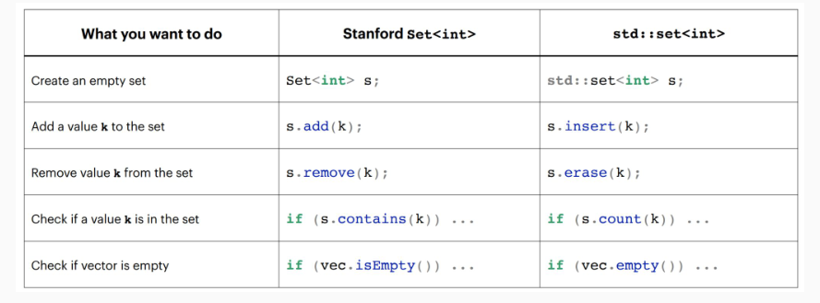
More differences

Slide 16
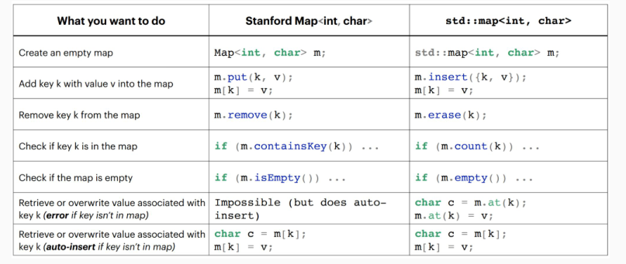
More differences

Slide 17
There are two types of containers:
Sequence:
● Containers that can be accessed sequentially
● Anything with an inherent order goes here!
Associative
● Containers that don’t necessarily
have a sequential order
● More easily searched
● Maps and sets go here!
All containers can hold all types of information! How do we choose which to use?

Slide 18
Vector implementation
How do vectors actually work?
● At a high level, a vector is an ordered collection of
elements of the same type that can grow and shrink in
size.
Internally, vectors implement an array!

Slide 19
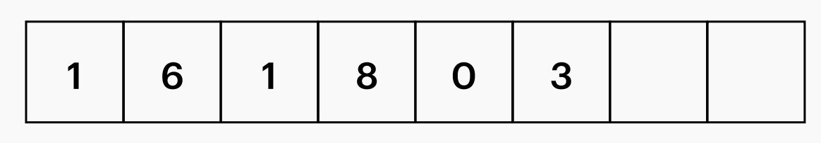
Vector implementation
We keep track of a few member variables:
● _size = number of elements in the vector
● _capacity = space allocated for elements
Don’t confuse these two!

Slide 20
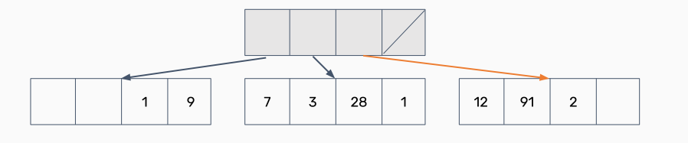
What about a deque?
Deques can be implemented many different ways! Here’s one:
● What if we had an array that stored other arrays?

Slide 21
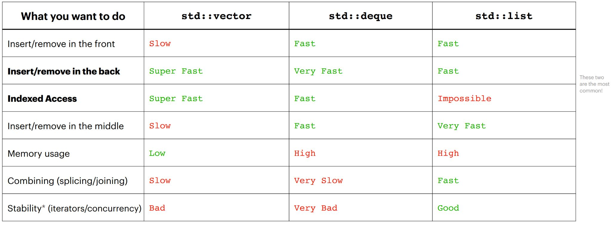
Choosing sequence containers

Slide 22
Sequence Containers: Summary
● Sequence containers are for when you need to enforce
some order on your information!
● Can usually use an std::vector for most anything
● If you need particularly fast inserts in the front, consider
an std::deque
● For joining/working with multiple lists, consider an
std::list (very rarely)

Slide 23
There are two types of containers:
Sequence:
● Containers that can be accessed sequentially
● Anything with an inherent order goes here!
Associative
● Containers that don’t necessarily
have a sequential order
● More easily searched
● Maps and sets go here!
All containers can hold all types of information! How do we choose which to use?

Slide 24
Map implementation
Maps are implemented with pairs! (std::pair<const key,
value>)
● Note the const! Keys must be immutable.
● Why a pair and not a tuple?

Slide 25
Unordered maps/sets
Both maps and sets in the STL have an unordered version!
● Ordered maps/sets require a comparison operator
to be defined.
● Unordered maps/sets require a hash function to be
defined.
Unordered maps/sets are usually faster than ordered ones!
Simple types are already natively supported; anything
else will need to be defined yourself.

Slide 26

Choosing associative containers
Lots of similarities between maps/sets! Broad tips:
● Unordered containers are faster, but can be difficult
to get to work with nested containers/collections
● If using complicated data types/unfamiliar
with hash functions, use an ordered container

Slide 27
So far:
● Sequence containers:
○ Arrays, vectors, deques, lists
● Associative containers:
○ Sets and maps
○ Unordered vs. ordered

Slide 28
Today
-Defining Containers
What is a container in C++?
- Containers in the STL vs Stanford
Types of containers and how they work
- Container Adaptors
Abstracting container implementation

Slide 29
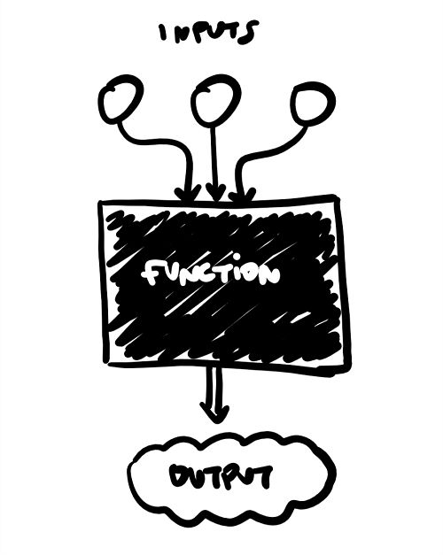
Container Adaptors
Container adaptors are “wrappers” to existing containers!
● Wrappers modify the interface to sequence
containers and change what the client is allowed to
do/how they can interact with the container.
● How could we make a wrapper to implement a queue
from a deque?

Slide 30
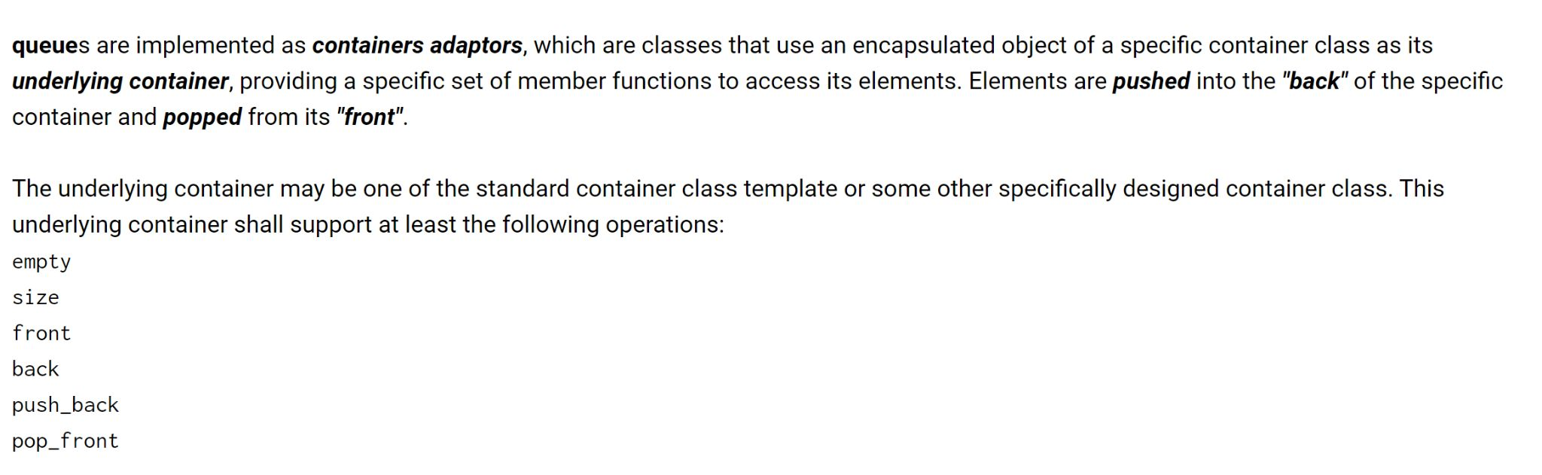
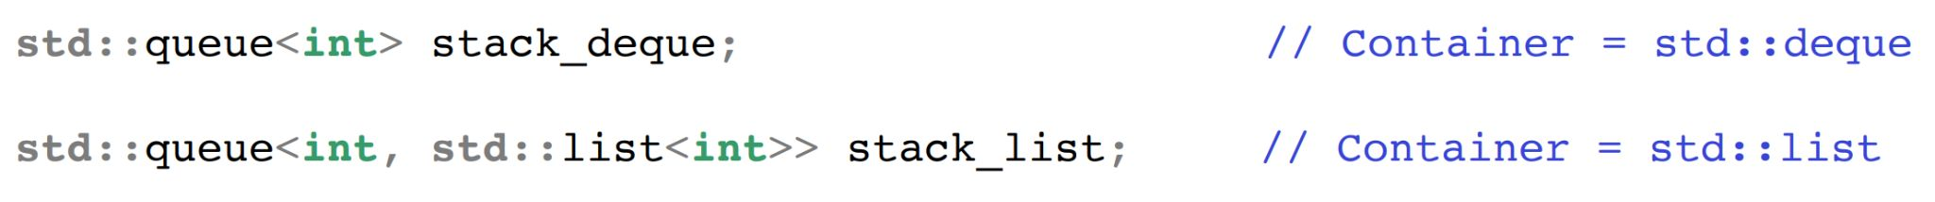
Let’s ask the STL!

Slide 31
Summary
● Containers are ways to collect related data together
and work with it logically
● Two types of containers: sequence and associative
● Container adaptors wrap existing containers to permit
new/restrict access to the interface for the clients.

Slide 32
Coding for love, Coding for the world
Qijun Zhao
qjzhao@scu.edu.cn

